Slide 1
HUMAN FOLLOWING ROBOT
D.UMESH KUMAR
Module_2 project
Ltts

Slide 2
Table of contents
Circuit diagram
Components needed
Overview
Sensors
Drive
Working
Algorithm
Conclusion

Slide 3
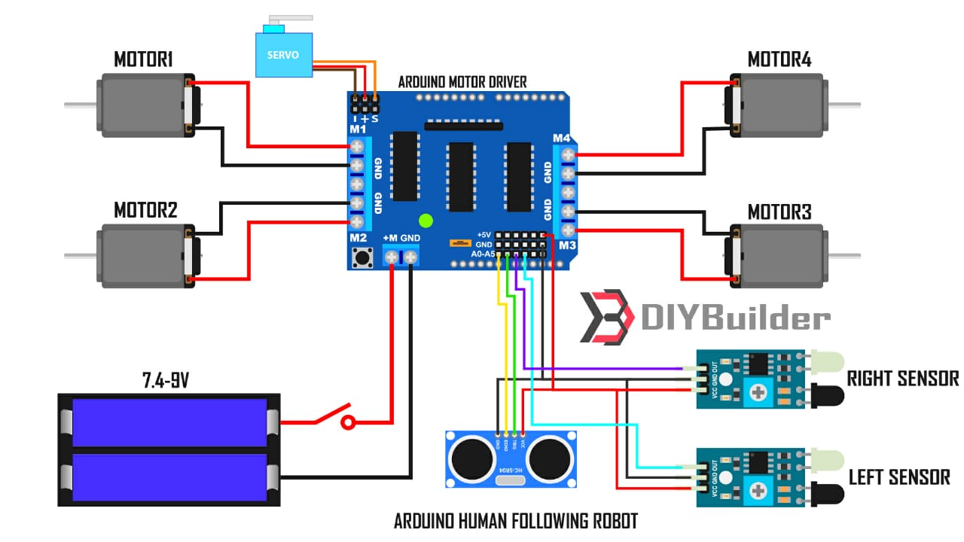
Circuit diagram

Slide 4
Software and hardware components needed
We use Arduino IDE as a software to give instructions to Arduino Uno
The hardware components used are
Arduino Uno
Motor drive shield
Wheels(4x)
TT gear motor(4x)
Servo motor
Ultrasonic sensor
Infrared sensor(2x)
Battery
Jumper wires
DC power switch

Slide 5
overview
Arduino IDE is a type microcontroller used to interpret the input signal and decide what to do
Sensor system :
Collects the information
Drive system :
Implements the signals for motor control
Here we use arduino IDE software to program the arduino

Slide 6
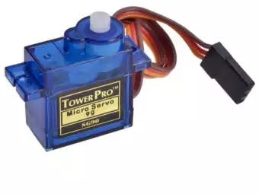
sensor
Servo motor
Servos have integrated gears and a shaft that can be precisely controlled. Standard servos allow the shaft to be positioned at various angles, usually between 0 and 180 degrees.

Slide 7
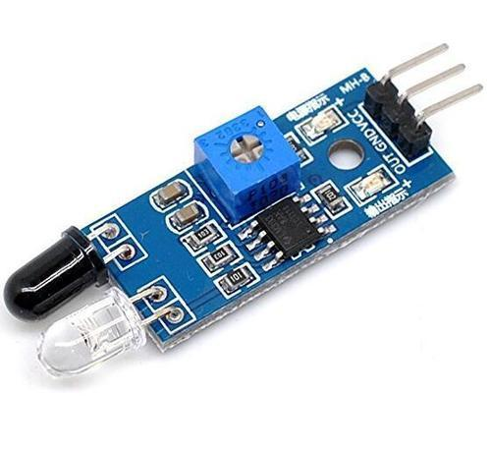
IR sensor
An infrared sensor is an electronic device, that emits in order to sense some aspects of the surroundings. An IR sensor can measure the heat of an object as well as detects the motion.

Slide 8
Drive
Dc motor is used to drive the wheels and motor drive gives the instructions to the motor
working
The IR sensor receives the analog signal (it detects the object around 100cm
radius ) . These signals are send to the Arduino , which creates digital signals
and then motor receives the digital signal and it moves forward

Slide 9
Human Following Algorithm
Robot determines the direction of movement by what it see’s
If the object( assume that the object is ‘hand’ ) is in front of the robot ,it moves forward towards the object and simultaneously
if the object is moving left or right then the robot continuous to follow the object . If there is no object detected the it remains in the stationary position

Slide 10
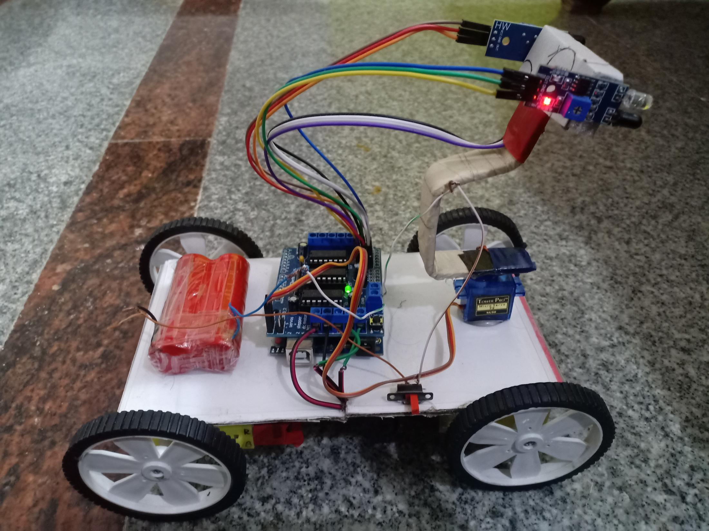
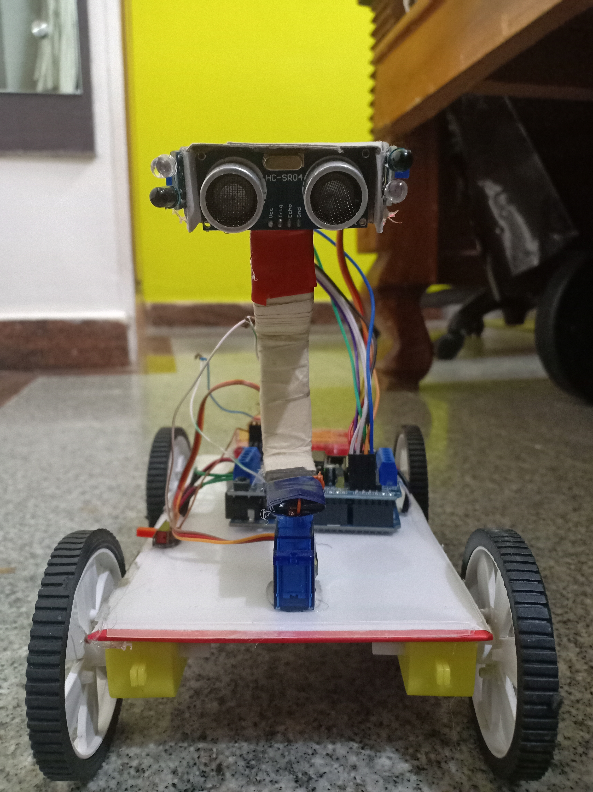
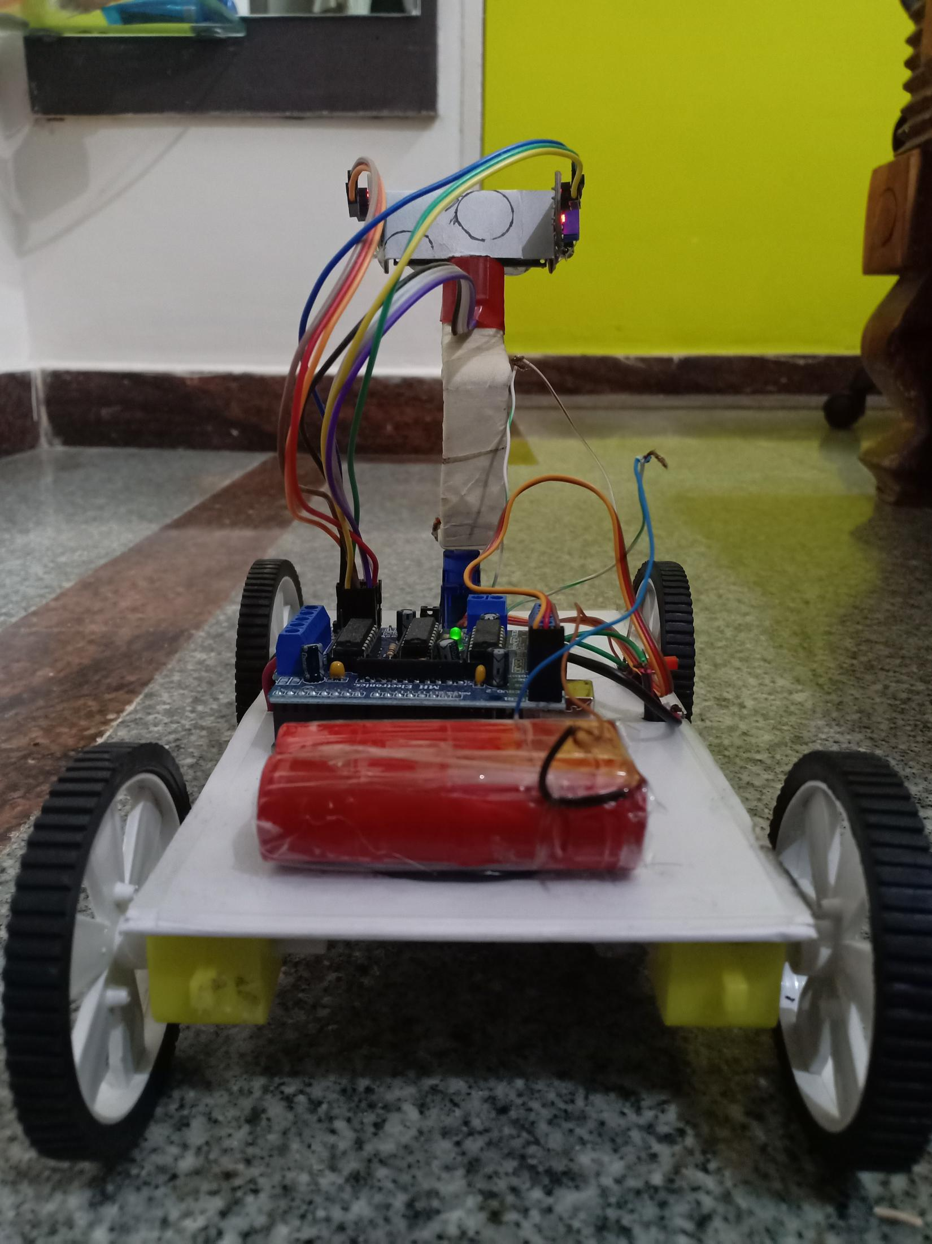
model made

Slide 11
Conclusion
A successful implementation of a follower robot is illustrated. This robot have the detection capability and also the tracking, following ability as well. The tests were performed on the different conditions to check the mistakes in the algorithm and correct them. The different sensors that are used with the robot add an additional advantage.

